Slide 1
Recognizing stages of Depression & Optimizing through Guided Imagery
PROGRESS SEMINAR 1
Session 2023-24
(G11)
Guided by
Prof. Nikita P. Giradkar
Projectees
Rishita Uikey
Saloni Urade
Arpita Mishra
Sakshi Deshmukh
Achal Akulwar

Slide 2
Problem Definition
Depression is increasing day by day and people are not aware of there suffering which leads to lack of activity and emotionally unstable (they fail to understand about emotion or their thinking) and in worst case death (suicide) is occur due to depression.
To decrease the death rate and optimize the disorder from beginner stage we are introducing our project which detect the depression and give solution through guided imagery.

Slide 3
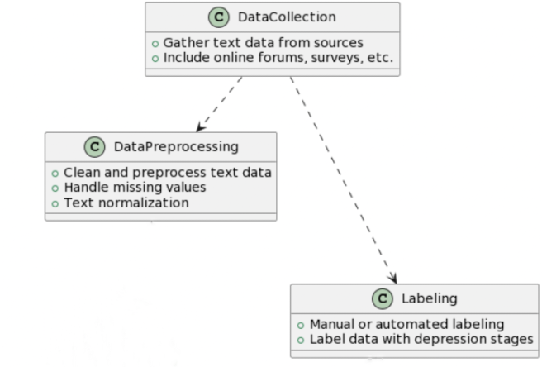
Work done till now

Slide 4
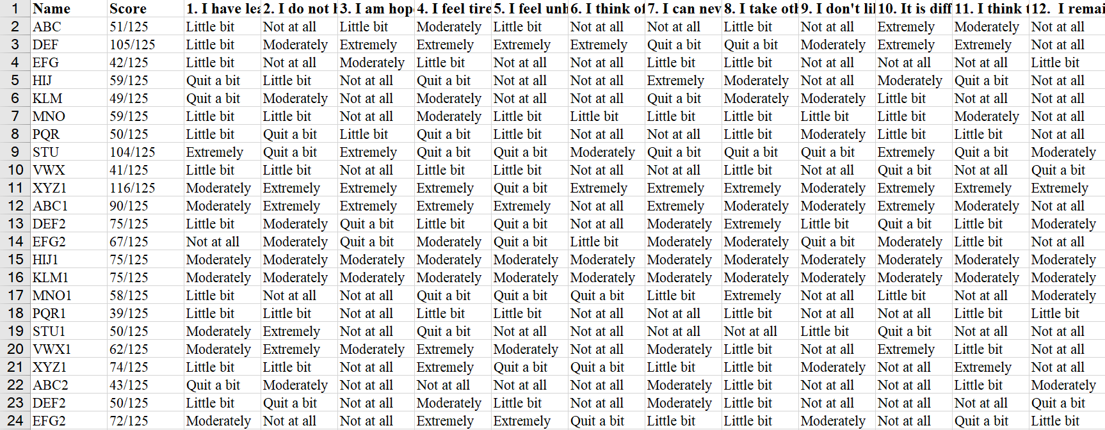
Dataset to Train the Model

Slide 5
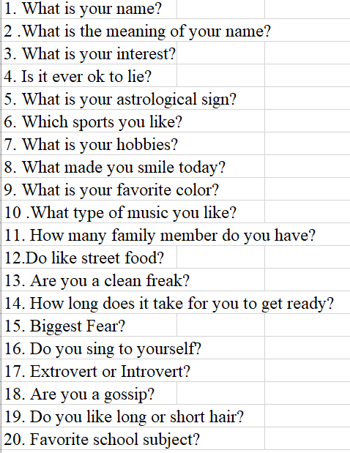
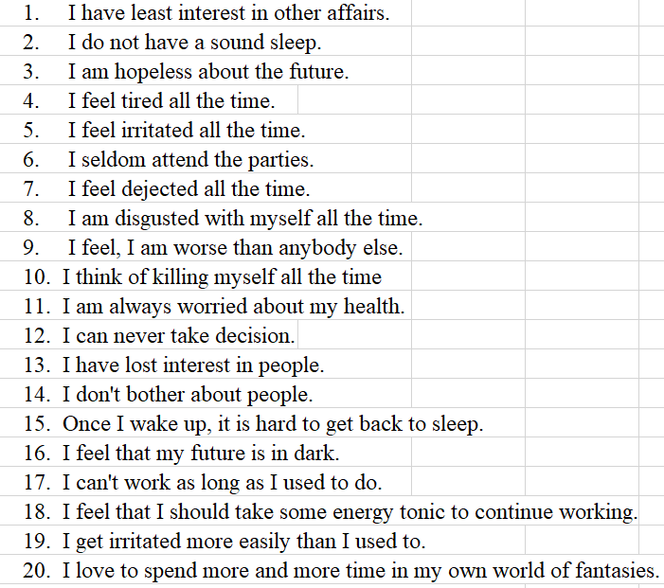
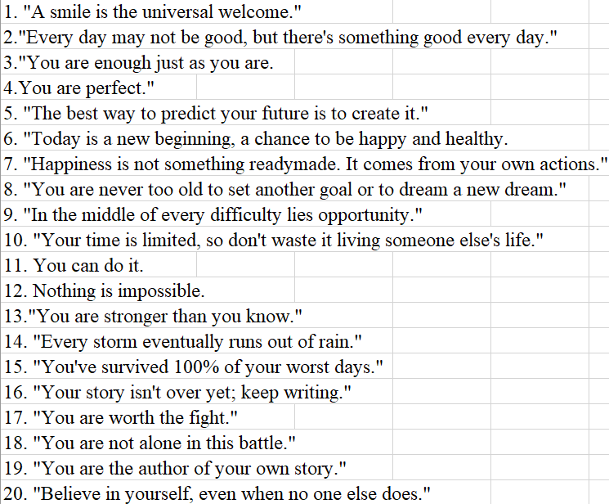
General Questions
Psychology questions
Happy quotes

Slide 6
Packages used
Flutter
Media Packages
flutter/material.dart
flutter/cupertino.dart
flutter/widgets.dart
dart:core
Sci-kit
NLTK libraries
Firebase

Slide 7
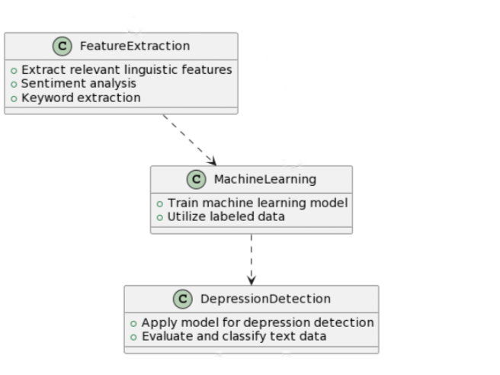
Work to be done

Slide 8
THANK YOU……

